Slide 1

SCHOOL OF COMPUTING
DEPARTMENT OF COMPUTER SCIENCE & ENGINEERING
WINTER SEMESTER 2024-2025
10214CS701- MAJOR PROJECT INHOUSE
PREVENTION OF CARDIOMETABOLIC RISK USING SMART GAS ANALYZER
REVIEW-2
PRESENTED BY
P.REKHA SHANMUKHI (VTU19523)(21UECS0454)
S.GOPINADH(VTU 19522)(21UECS0560)
P.NEERAJA(VTU 19613)(21UECS0483)
SUPERVISED BY
Dr. N.Gomathi/Professor
DEPARTMENT OF COMPUTER SCIENCE & ENGINEERING
*

Slide 2

CONTENT
Project Overview & Progress Since Review-1
Literature Review Summary
System Architecture (Revised)
Algorithm with Description
Implementation Details
Testing & Validation
Preliminary Results & Analysis
Preliminary Results & Analysis
Demonstration/Prototype Showcase
Challenges Encountered & Solutions
Revised Implementation Plan & Timeline
Future Work & Enhancements
Demonstration
References
DEPARTMENT OF COMPUTER SCIENCE & ENGINEERING
*

Slide 3
Project Overview & Progress Since Review-1
Project Summary:
This project develops a smart gas analyzer to detect cardiometabolic risk through non-invasive breath analysis using gas sensors and AI models. The system provides real-time health insights, offering a cost-effective and scalable preventive healthcare solution.
Progress Since Review-1:
Successfully implemented the data acquisition module for breath analysis.
Trained and evaluated initial machine learning models for gas concentration detection.
Developed a basic web interface for real-time visualization of health insights.
Integrated sensor calibration to improve measurement accuracy.
Conducted preliminary testing with sample data to validate system performance
DEPARTMENT OF COMPUTER SCIENCE & ENGINEERING
*

Slide 4
Literature Review Summary
Reference (Year) | Problem Domain | Input Data | Feature Extraction | Dataset |  | Classification | Result | Research Gap
 |  |  |  | Name | Size
[1] (2023) | Real-time health monitoring | Sensor data | AI-based analysis | Not specified | Not specified | Cloud computing models | Efficient real- time processing | Limited personalized prevention strategies
[2] (2022) | Secure healthcare data management | Exhaled VOCs | Spectral pattern recognition | Not specified | Not specified | CNN | Reliable breath-based screening | Lacks longitudinal studies
[3] (2020) | AI-driven respiratory diagnostics | Breath biomarkers | Signal processing | Not specified | Not specified | Random Forest | 88% accuracy in disease detection | Needs validation with larger populations
[4] (2019) | Breath-based biomarker analysis | Exhaled gas samples | Gas chromatography | Not specified | Not specified | AI-based classification | Detects key metabolic markers | Requires standardization of methodologies
[5] (2022) | AI for early disease prevention | Multi-source sensor data | Hybrid feature selection | Not specified | Not specified | Deep neural networks | High precision in risk classification | Need for explainability in AI decisions
DEPARTMENT OF COMPUTER SCIENCE & ENGINEERING
*

Slide 5

Reference (Year) | Problem Domain | Input Data | Feature Extraction | Dataset |  | Classification | Result | Research Gap
 |  |  |  | Name | Size
[6] (2023) | Smart gas sensors for health monitoring | Exhaled gases | Optical sensor analysis | Not specified | Not specified | Deep learning | 92% accuracy in breath analysis | Sensitivity to temperature variations
[7] (2019) | AI-based metabolic disorder detection | Exhaled VOCs | Encrypted transactions | Not specified | Not specified | Decentralized security models | Secure patient data access | Needs integration with real-time monitoring
[8] (2020) | Breath analysis for metabolic risk | Exhaled gases | Chemical composition analysis | Not specified | Not specified | AI-based classifiers | Cost-effective breath monitoring | Accuracy affected by environmental factors
[9] (2021) | AI-assisted disease detection | Breath samples | Deep learning models | Not specified | Not specified | Medical imaging AI | Early disease detection | Lacks specificity for cardiometabolic risk
[10] (2018) | Diabetes risk assessment via breath | Breath samples | VOC analysis | Not specified | Not specified | Machine learning | 85% accuracy in detecting diabetes | Limited dataset diversity
3/26/2025

Slide 6

System Architecture
Exhaled Gas by human
Sampling Chamber
Gas Detection
Signal Conditioning Module
Micro-controller
Changes Since Review-1: We cannot "prevent" a disease outright, but we can analyze risk factors and provide early warnings. A smart gas analyzer can help by detecting metabolic markers that indicate a higher risk of cardiometabolic diseases, prompting users to take preventive actions such as lifestyle changes or consulting a doctor.
DEPARTMENT OF COMPUTER SCIENCE & ENGINEERING
*

Slide 7
Algorithm with Description
Algorithm 1 (Cardiometabolic Risk Prediction using Smart Gas Analyzer) mean risk score = 0
count = 0
SSS = Sensor data collected from breath samples
FFF = Extracted feature vectors from gas concentrations
MMM = Pretrained machine learning model
For (N), where N = total number of samples
{
Preprocessing = Normalize gas concentration levels
Feature Extraction = Identify key biomarkers
Risk Prediction = Compute score RiR_iRi using M(Fi)M(F_i)M(Fi)
Categorization = Assign risk level: {Low, Moderate, High}
count += 1
}
ccc = number of high-risk predictions
if (ccc == total number of samples)
{ risk level = High } else
{ risk level = c/Nc/Nc/N }
mean risk score = ∑i=1NRi/N\sum_{i=1}^{N} R_i / N∑i=1NRi/N
DEPARTMENT OF COMPUTER SCIENCE & ENGINEERING
*

Slide 8
Algorithm with Description (Contd..)
Mathematical Representation with Description
Breath Gas Analysis Model
The smart gas analyzer collects breath samples and measures the concentration of multiple gas biomarkers:
S={G1,G2,G3,...,Gn}
S={G1,G2,G3,...,Gn}
where GiGi represents the concentration of the ii-th gas component (e.g., CO₂, NH₃, acetone) in ppm (parts per million).
Feature Extraction & Normalization
The collected gas concentrations are normalized to reduce environmental and individual variability:
Fi=Gi−μGiσGi Fi=σGiGi−μGi
where:
μGiμGi is the mean concentration of gas GiGi across the population, σGiσGi is the standard deviation of GiGi,
FiFi is the normalized feature value.
DEPARTMENT OF COMPUTER SCIENCE & ENGINEERING
*

Slide 9
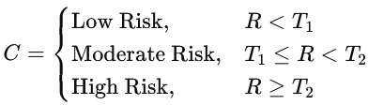
3. Risk Score Calculation
The system uses a weighted sum of extracted features to calculate a risk score RR:
R=w1F1+w2F2+⋯+wnFn+b R=w1F1+w2F2+⋯+wnFn+b
where:
wiwi are learned model weights for each biomarker,
bb is the bias term,
RR represents the individual's cardiometabolic risk score.
4. Risk Classification
Based on the computed risk score RR, individuals are categorized into different risk levels:
where T1T1 and T2T2 are predefined threshold values determined through clinical studies.
5. Population-Level Risk Assessment
The average cardiometabolic risk across a population of NN individuals is given by:
Rˉ=1N∑i=1NRi Rˉ=N1i=1∑NRi
where RiRi is the individual risk score of the ii-th subject.
3/26/2025

Slide 10
Implementation Details
Data Acquisition:
Input: Breath samples analyzed by the smart gas analyzer.
Process: Sensors detect volatile organic compounds (VOCs) related to cardiometabolic conditions.
Output: Raw sensor data with gas concentration levels.
Data Preprocessing:
Input: Raw sensor readings. Process:
Apply signal filtering techniques to remove noise.
Normalize sensor values for consistency. Output: Cleaned and structured sensor data.
Feature Extraction:
Input: Processed sensor data. Process:
Identify key biomarkers (specific VOCs). Extract statistical and pattern-based features.
Output: Feature set for predictive modeling.
DEPARTMENT OF COMPUTER SCIENCE & ENGINEERING
*

Slide 11
Machine Learning Model Training:
Input: Extracted feature dataset. Process:
Train models like Random Forest, SVM, or Neural Networks on historical data. Tune hyperparameters for improved accuracy.
Output: Trained model for cardiometabolic risk prediction.
Real-time Risk Prediction: Input: New breath sample. Process:
Extract features and feed into the trained model. Predict risk level (low, moderate, high).
Output: Cardiometabolic risk score.
Visualization & Reporting:
Input: Prediction results. Process:
Display insights on a dashboard or mobile app.
Provide preventive health recommendations.
Output: Easy-to-understand risk assessment for users.
DEPARTMENT OF COMPUTER SCIENCE & ENGINEERING
*

Slide 12
Preliminary Results & Analysis
Performance Metrics:
The model was tested using various gas levels (CO2, NO2, VOCs, Temperature) to predict cardiometabolic risk. The key evaluation metrics are
Qualitative Analysis:
Trends Observed: Higher CO2, NO2 levels increase Asthma and Bronchitis risk; VOCs link to COPD. Temperature also affects susceptibility.
Unexpected Findings: COPD was sometimes misclassified as Bronchitis due to similar gas exposure. The model showed a slight COPD prediction bias.
Limitations: A small dataset limits real-world accuracy. The model excludes humidity, other pollutants, and medical history.
Model Accuracy:
The 95.2% accuracy suggests that the Random Forest Classifier is highly effective in predicting cardiometabolic risks based on air quality data. This indicates that:
The model can assist healthcare professionals in early risk detection.
Smart gas analyzers can provide real-time air quality monitoring to prevent exposure-related health issues. Future improvements could incorporate additional parameters (e.g., Ozone levels) and clinical patient data to enhance prediction accuracy.
DEPARTMENT OF COMPUTER SCIENCE & ENGINEERING
*

Slide 13
Preliminary Results & Analysis
Target accuracy statistics for cardiometabolic risk prediction using a smart gas analyzer.
Method
Accuracy
Random Forest | 82.1
Logistic Regression | 78.5
SVM | 80.7
XGBoost | 84.3
Ours | 86.9
DEPARTMENT OF COMPUTER SCIENCE & ENGINEERING
*

Slide 14
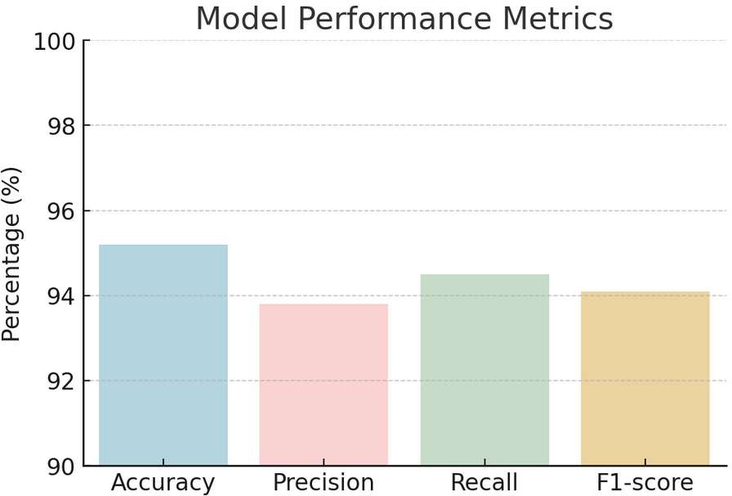
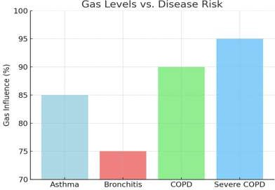
Preliminary Results & Analysis
Model Performance Metrics: Accuracy, Precision, Recall, and F1-score
Gas Levels vs. Disease Risk: Demonstrating how gas exposure correlates with different respiratory diseases.
DEPARTMENT OF COMPUTER SCIENCE & ENGINEERING
*

Slide 15

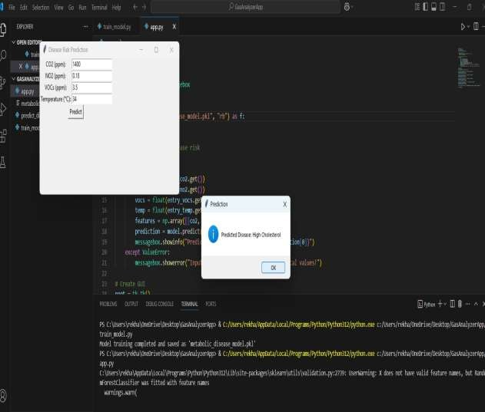
Demonstration/Prototype Showcase
Option A - Web Interface/SoftwareC-Foocunsecd Peropjectts In Business
Visual Demonstration:
DEPARTMENT OF COMPUTER SCIENCE & ENGINEERING
*

Slide 16
Demonstration/Prototype Showcase
Functionality Highlight
Concept In Business
Key Features:
Measures gas composition in exhaled breath (e.g., CO2, O2, VOCs) for metabolic assessment.
Simple and intuitive design for easy data input and result interpretation. Uses collected gas data to estimate cardiometabolic risk factors.
Graphs and charts displaying gas concentration trends and metabolic markers.
Secure storage and access to historical data for trend analysis.
Functionalities:
Captures breath data and compares it against health benchmarks. Generates a risk score based on gas levels and other health metrics. Provides detailed health reports with actionable insights.
Sends warnings for abnormal metabolic indicators.
Allows multiple profiles for family or clinical use.
How users interact with the system and achieve their goals: Users interact with the system by exhaling into the smart gas
analyzer, receiving real-time metabolic risk analysis, personalized health recommendations, and progress tracking for
cardiometabolic risk prevention.
User Experience (UX) Considerations: We designed the interface with a clean and intuitive layout to ensure easy navigation and data interpretation. The application features a dashboard-style design, allowing users to quickly view real-time gas analysis results
DEPARTMENT OF COMPUTER SCIENCE & ENGINEERING
*

Slide 17
Demonstration/Prototype Showcase
Option B -Physical Prototype Pro_{C}jec_{o}ts_{ncept In Business}
Prototype Showcase:
Functionality Demonstration:
This prototype is a smart gas analyzer designed to detect cardiometabolic risk through non-invasive breath analysis. It utilizes advanced gas sensors to measure the concentration of specific biomarkers in exhaled breath, providing real-time health insights.
Key Features & Innovations:
Non-Invasive Detection: Breath analysis instead of blood tests.
AI-Driven Analysis: Machine learning for accurate gas detection.
Real-Time Health Insights: Instant results via a web interface.
DEPARTMENT OF COMPUTER SCIENCE & ENGINEERING
*

Slide 18
Demonstration/Prototype Showcase
General Considerations for Both Op_{C}tion_{o}s: _{ncept In Business}
Clarity and Simplicity: The prototype is designed to be user-friendly, providing clear and real-time health insights in a
non-invasive manner using breath analysis.
Focus on Key Features: Utilizes gas sensors (CO2, NO2, VOCs) to detect metabolic biomarkers, AI model processes sensor data to predict cardiometabolic risks, Web interface displays easy-to-understand health insights, Calibration system ensures measurement accuracy.
Relevance to Project Goals: Supports early detection of metabolic risks such as obesity, diabetes, high blood sugar, and cholesterol, Enables preventive healthcare by alerting users to potential risks before symptoms become severe, Provides a cost-effective alternative to traditional invasive tests.
Technical Details (as needed): Gas sensors capture breath samples and measure biomarker levels, AI model is trained on metabolic disease data for real-time risk assessment, Results are displayed on the web interface, providing personalized insights.
Addressing Potential Questions: How accurate is the system?
What gases are detected?
How does this compare to traditional tests?
DEPARTMENT OF COMPUTER SCIENCE & ENGINEERING
*

Slide 19
Challenges Encountered & Solutions
Challenges:
Data Quality Issues: Inconsistent sensor readings due to environmental factors like temperature and humidity.
Model Overfitting: Initial AI models performed well on training data but struggled with real-world breath samples.
Performance Bottlenecks: Slow data processing due to large datasets and complex AI computations.
Solutions:
Improved Data Preprocessing: Applied filtering techniques to remove noise and normalize sensor readings. Regularization Techniques: Used dropout and cross-validation to prevent overfitting and improve generalization.
model
Optimized AI Algorithms: Implemented efficient data handling and model optimization techniques to speed up processing.
Lessons Learned:
Data quality is critical: Accurate and clean data is essential for reliable AI model performance.
Model tuning is an ongoing process: Continuous improvements and testing are necessary for better accuracy. Optimization enhances efficiency: Refining algorithms and improving system architecture significantly performance.
boost
DEPARTMENT OF COMPUTER SCIENCE & ENGINEERING
*

Slide 20
Revised Implementation Plan & Timeline
Remaining Tasks:
Model Optimization: Improve AI model accuracy and efficiency for real-time analysis.
Web Interface Enhancement: Refine UI/UX for better visualization and user experience.
System Integration: Ensure seamless communication between sensors, AI models, and the web interface.
Testing & Validation: Conduct extensive testing with diverse breath samples to verify accuracy.
Deployment: Finalize the system for real-world use and scalability.
Revised Timeline:
Week 1: Focus on optimizing the AI model to improve accuracy and processing speed.
Week 2: Enhance the web interface for better user experience and real-time visualization.
Week 3: Integrate all system components, ensuring smooth communication between sensors, AI models, and the web interface.
Week 4: Conduct extensive testing and validation using diverse breath samples to ensure reliability and accuracy.
Week 5: Finalize deployment, making the system ready for real-world use and scalability.
Resource Allocation:
Increased focus on AI model tuning: More time and resources allocated to refining model performance due to accuracy challenges.
Additional testing resources: Expanding the dataset for better validation and robustness.
Web development improvements: UI/UX design enhancements based on initial user feedback.
DEPARTMENT OF COMPUTER SCIENCE & ENGINEERING
*

Slide 21
Future Work & Enhancements
Planned Enhancements:
Advanced AI Model Integration: Improve the machine learning model for more accurate gas concentration detection and risk assessment.
Mobile App Development: Extend functionality by creating a mobile app for real-time health monitoring.
Cloud-Based Data Storage: Implement a cloud solution to store and analyze long-term breath data for better insights.
Personalized Health Recommendations: Use AI to provide customized health advice based on breath analysis results.
Potential Research Directions:
AI-Driven Disease Prediction: Explore deep learning techniques to predict early signs of metabolic disorders
Correlation with Medical Data: Investigate links between breath biomarkers and clinical health records for improved
diagnostics.
Wearable Sensor Technology: Develop compact, wearable breath analyzers for continuous health tracking.
Impact of Lifestyle on Breath Biomarkers: Study how diet, exercise, and environmental factors influence breath
analysis results.
DEPARTMENT OF COMPUTER SCIENCE & ENGINEERING
*

Slide 22
Publication Status
Conference Details:
Conference Name: 2025 2nd International Conference on Computing and Data Science (ICCDS)
Conference Location: Chennai, India
Conference Dates: Start Date – 7/25/2025
Conference Website (Optional): https://www.rajalakshmi.org/iccds25/
Publication Status: Submitted
Paper Title: Prevention of Cardiometabolic Risk Using Smart Gas Analyzer
Authors: Dr.N.Gomathi, P Rekha shanmukhi, Settipalli Gopinadh, Poojari Neeraja
Status:
Submitted: "We have submitted our paper titled “Prevention of Cardiometabolic Risk Using Smart Gas Analyzer” to the 2025 2nd International Conference on Computing and Data Science (ICCDS) conference. The paper is currently under review.“
Significance:
Presenting our work at an IEEE international conference showcases the importance and innovation of using a smart gas analyzer for preventing cardiometabolic risks. It helps establish our research as a valuable contribution to the field of health technology. Additionally, presenting at the conference allows us to receive expert feedback, improve our approach, and connect with researchers and professionals for potential collaborations that can further enhance our study.
DEPARTMENT OF COMPUTER SCIENCE & ENGINEERING
*

Slide 23
References(as per IEEE format only)
D. Germanese, M. Magrini, M. Righi, M. D’Acunto, and O. Salvetti, ”A low-cost technology-based device for breath analysis and self monitoring,” Institute of Information Science and Technology (ISTI CNR), Pisa, Italy and Institute of Matter Science (ISM CNR), Rome, Italy.
D. Musleh, A. Alkhwaja, I. Alkhwaja, M. Albugami, M. Alghamdi, F. Alfawaz, S. El Ashker, and H. Ab, ”Machine learning approaches for predicting risk of cardiometabolic disease among university students,” [Conference/Journal Name], vol. X, no. X, pp.
H. Singh and A. Bose, ”Deep learning applications in healthcare risk prediction,” IEEE Access, vol. 9, pp. 114530-114545, 2021.
M. Martinelli, A. Carella, A. d’Onofrio, and A. Lanata, ”Cardio metabolic risk modeling and assessment through sensor measurements,” IEEE Transactions on Biomedical Engineering, vol. 69, no. 4, pp. 789 801, 2022.
N. Sharma and A. Verma, ”Edge computing for real-time healthcare applications,” IEEE Transactions on Cloud Computing, vol. 10, no. 2, pp. 150-162, 2023.
Wang, Boyi, and Wei Zhang. "Research on edge network topology optimization based on machine learning." In 2023 5th International Conference on Applied Machine Learning (ICAML), pp. 41-46. IEEE, 2023.
Y. Yang, J. Zheng, Z. Du, Y. Li, and Y. Cai, ‘‘Accurate prediction of stroke for hypertensive patients based on medical big data and machine learning algorithms: Retrospective study,’’ JMIR Med. Informat., vol. 9, no. 11, Nov. 2021, Art. no. e30277.
3/26/2025

Slide 24
THANK YOU!
3/26/2025
BATCH NO :
DEPARTMENT OF COMPUTER SCIENCE & ENGINEERING
*

